Slide 1
Temperature Sensor and Visualizer with Pic24 Microcontroller
Truman Brown
Notes:
Hello, I’m Truman Brown and my final project was implementing a temperature sensor and visualizer with the PIC24 Microcontroller

Slide 2
Overview
Temperature Sensor
Read temperature
Send data
LCD
Display temperature data as string
iLED
Visualize temperature as color
Fade blue to red
Goal:
Assemble temperature sensor, LCD, and iLED to work together
MCP9808 High Accuracy I2C
Temperature Sensor Breakout Board
Akizuki/Sitronix Controlled LCD
WS2812 iLED
Helpful additions:
Push-button switch
Debugging LED
PIC24 Microcontroller
Notes:
So this slide documents the general overview and goal of my final project. My starting goal was to successfully assemble a temperature sensor, LCD, and iLED to work together. As for the components used, I used the MCP9808 High Accuracy IsquaredC temperature breakout board, the sitronix controlled LCD, and the WS2812 RGB ilED. As I was working on my project, I realized a few helpful additions and decided to add them to my final project. Those helpful additions were a push button switch that I added as a double click detector. When a double click was detected, it would then switch the temperature readings from Celsius to Fahrenheit and vice versa. Additionally, I added a debugging simple LED to help debug any I2C issues.
To be a little more specific, my overview for my project included the following. First, I wanted the temperature sensor to read the temperature of its surroundings, and then send that data to the PIC24. Then, I wanted the PIC24 to convert that data to a string and then send that string data of the temperature to the LCD and display it. Finally, I wanted the PIC24 to visualize the temperature onto a RGB LED by fading the colors from blue to red and red to blue based on the temperature. Specifically, I wanted the LED to hover around the color purple at room temperature, then if the temperature on the sensor increases, the LED will fade to a deeper red, while if the temperature decreases, the LED will fade to blue. An example of this behavior is recorded in my demo video.

Slide 3
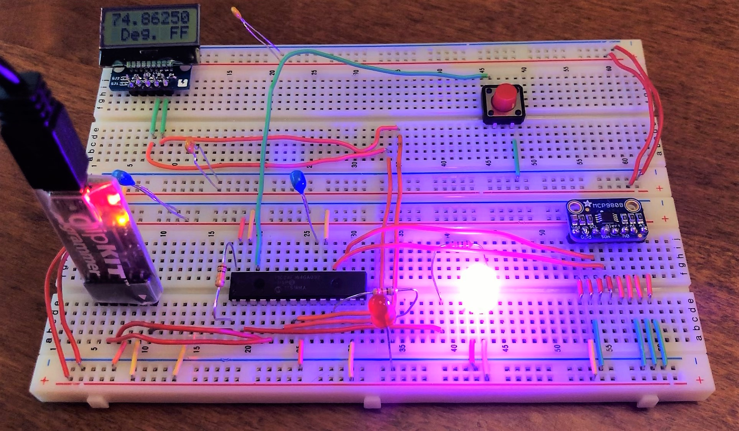
Circuit
Notes:
I decided to include a picture of my circuit in this presentation as well. *EXPLAIN*

Slide 4
Libraries Needed
Assembly Library
Various delays (100μs, 1ms)
iLED Library
Write Pulses functions on RA0
0.35μs in 1.25μs period
0.70μs in 1.25μs period
Setup the LED
I/O, 16MHz, etc.
Variable delay
# of ms delay
Write a color to the LED
Controlled with red, green blue values
0-255 value for each color
Notes:
The first library needed was an assembly library that I developed in lab 2 of this class. The library was written in the PIC assembly language, and it served many purposes. First, it created various delays by repeating the “no operation” command in assembly a specific number of times, to get 100 microsecond and 1 millisecond delays. Additionally, the library included functions that would write different pulses to the RA0 pin. These pulses were either 0.35 microseconds high in a 1.25 microsecond period or 0.70 microseconds high in a 1.25 microsecond period.
The second library needed was the library that had all functions related to the iLED. I developed this library during lab 2 of this class as well. This library included functions to set up the iLED such as making RA0 an output pin and setting the PIC24 to run at 16MHz. Additionally, there was a function that created a variable number of ms delays using the 1ms delay function from the assembly library. Finally, there was a function that wrote a specific rgb color to the iLED using the write pulses functions from the assembly library. The function took a value 0-255 for red, green, and blue.

Slide 5
Libraries Needed (Cont.)
LCD Library
Setup the LCD
Temperature Sensor Library
I2C, IF cleared, etc.
Minimum frequency of 100 kHz
Write commands to the LCD
Initialize the LCD with series of commands
Set the cursor on the LCD
Row, column
Write a single character to the LCD
Write a string/constant array of characters to LCD
Initialize the temperature sensor
Minimum frequency of 100 kHz
Initialized to idle condition
Initiate the start condition for the data transfer protocol
Initiate the stop condition for the data transfer protocol
Write data to the temperature sensor
Return either acknowledge status
Read digital temperature data from sensor
Configure the sensor with series of writes
Initialize the double click detector on the button-switch
Notes:
The third library was the LCD library that contained all functions for the LCD. This library was developed during lab 5 of this class and had many functions. The first was setting up the LCD and the I2C protocol by clearing the flag, enabling I2C and setting the minimum frequency to 100 kHz. Then there was a function that wrote a single character command to the LCD. This function was then used in the initialization function that wrote many commands to the LCD to initialize it. There were also functions to set the cursor on the LCD, to write a single character to the LCD, and to write a string or a constant array of characters to the LCD.
The final library was the MCP9808 Temperature Sensor Library. This library contained various I2C protocol functions like functions to start data transfer, to stop data transfer, to write data to the sensor, and then to read data from the sensor. Finally, the library contained functions to configure the sensor and also included a function that initialized the button-switch to act as a double click detector.

Slide 6
How all the libraries work together in main
Call all setup functions from all libraries (setupLED(), setupLCD(), lcd_init(), etc.)
Initialize necessary variables
Char array to store floating point value of temperature
Two arrays of size 255 to store “checkpoints” of temperatures to compare to sensor reading
{70.0, 69.85, 69.70, 69.55,.....,(70-i*0.15)}, {70.0, 70.15, 70.30, 70.45,.....,(70+i*0.15)}
While(1) loop
Read temperature sensor data into two bytes as required by MCP9808 sensor using temperature sensor library functions
Display temperature value on LCD using LCD library functions
Switch between Celsius and Fahrenheit
Fade iLED between blue and red in correspondence to temperature readings from sensor
Uses iLED library functions to write the color to the LED.

Slide 7
Problems Encountered and their solutions
Getting the temperature sensor configured correctly
The datasheet along with the LCD I2C experience helped
Converting the ambient temperature sensor register into a decimal value
Studying two’s complement again to better understand how to convert
Fading the iLED smoothly between red and blue
Switched while loops of checkpoints to an array of checkpoints

